Slide 1

COMPUTER SYSTEMS
Junaid saeed

Slide 2
WHAT IS COMPUTER?
The word is derived from ‘compute’, which means to calculate.
A computer is a electronic device that can perform a variety of tasks by executing a given set of instructions.
It is versatile and can handle multiple tasks like documentations, accountings , designing and many more.
The acronym for COMPUTER is Common Oriented Machine Particularly Used for Trade and Education Research.

Slide 3
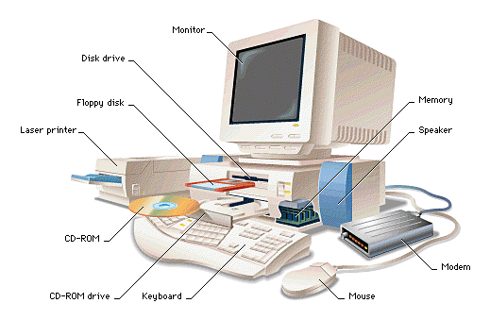

Slide 4
CHARACTERISTICS OF A COMPUTER
Speed
Accuracy
Reliability
Storage Capacity
Versatility
Reduction in Manpower
Reduction in paper work

Slide 5
PARTS OF A COMPUTER
CPU
Monitor
Mouse
Key Board
Printer
Modem

Slide 6
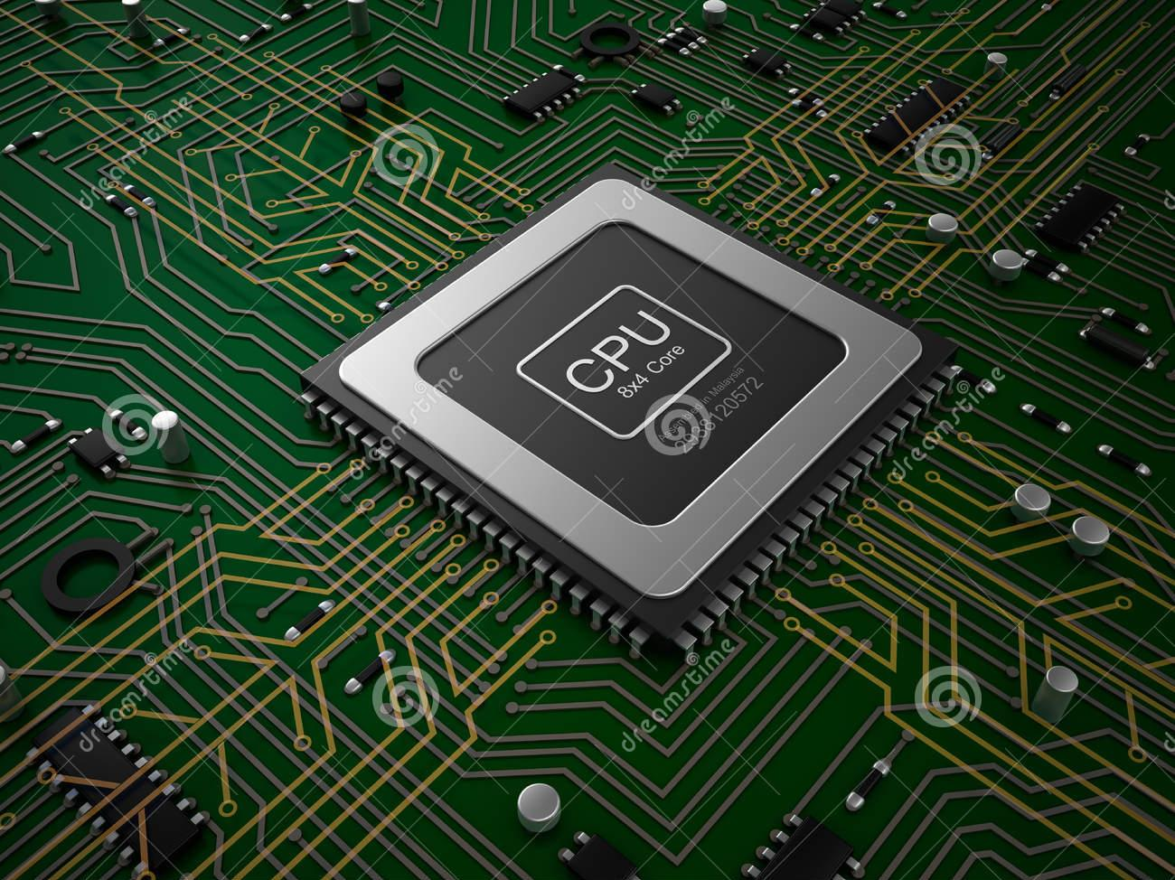
CENTRAL PROCESSING UNIT
A central processing unit (CPU) is an electronic circuitry within a computer that carries out the instructions of a computer program by performing the basic arithmetic , logical, control and input /output (I/O) operations specified by the instructions.

Slide 7
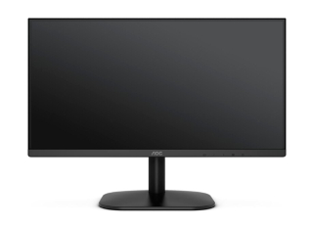
MONITOR
A monitor or display is an electronic visual display for computers .
The display devices in modern monitors is typically a thin film transistor liquid crystal display (TFT-LCD) thin panel , while older monitors used a cathode ray tube (CRT) about as deep as the screen size.

Slide 8
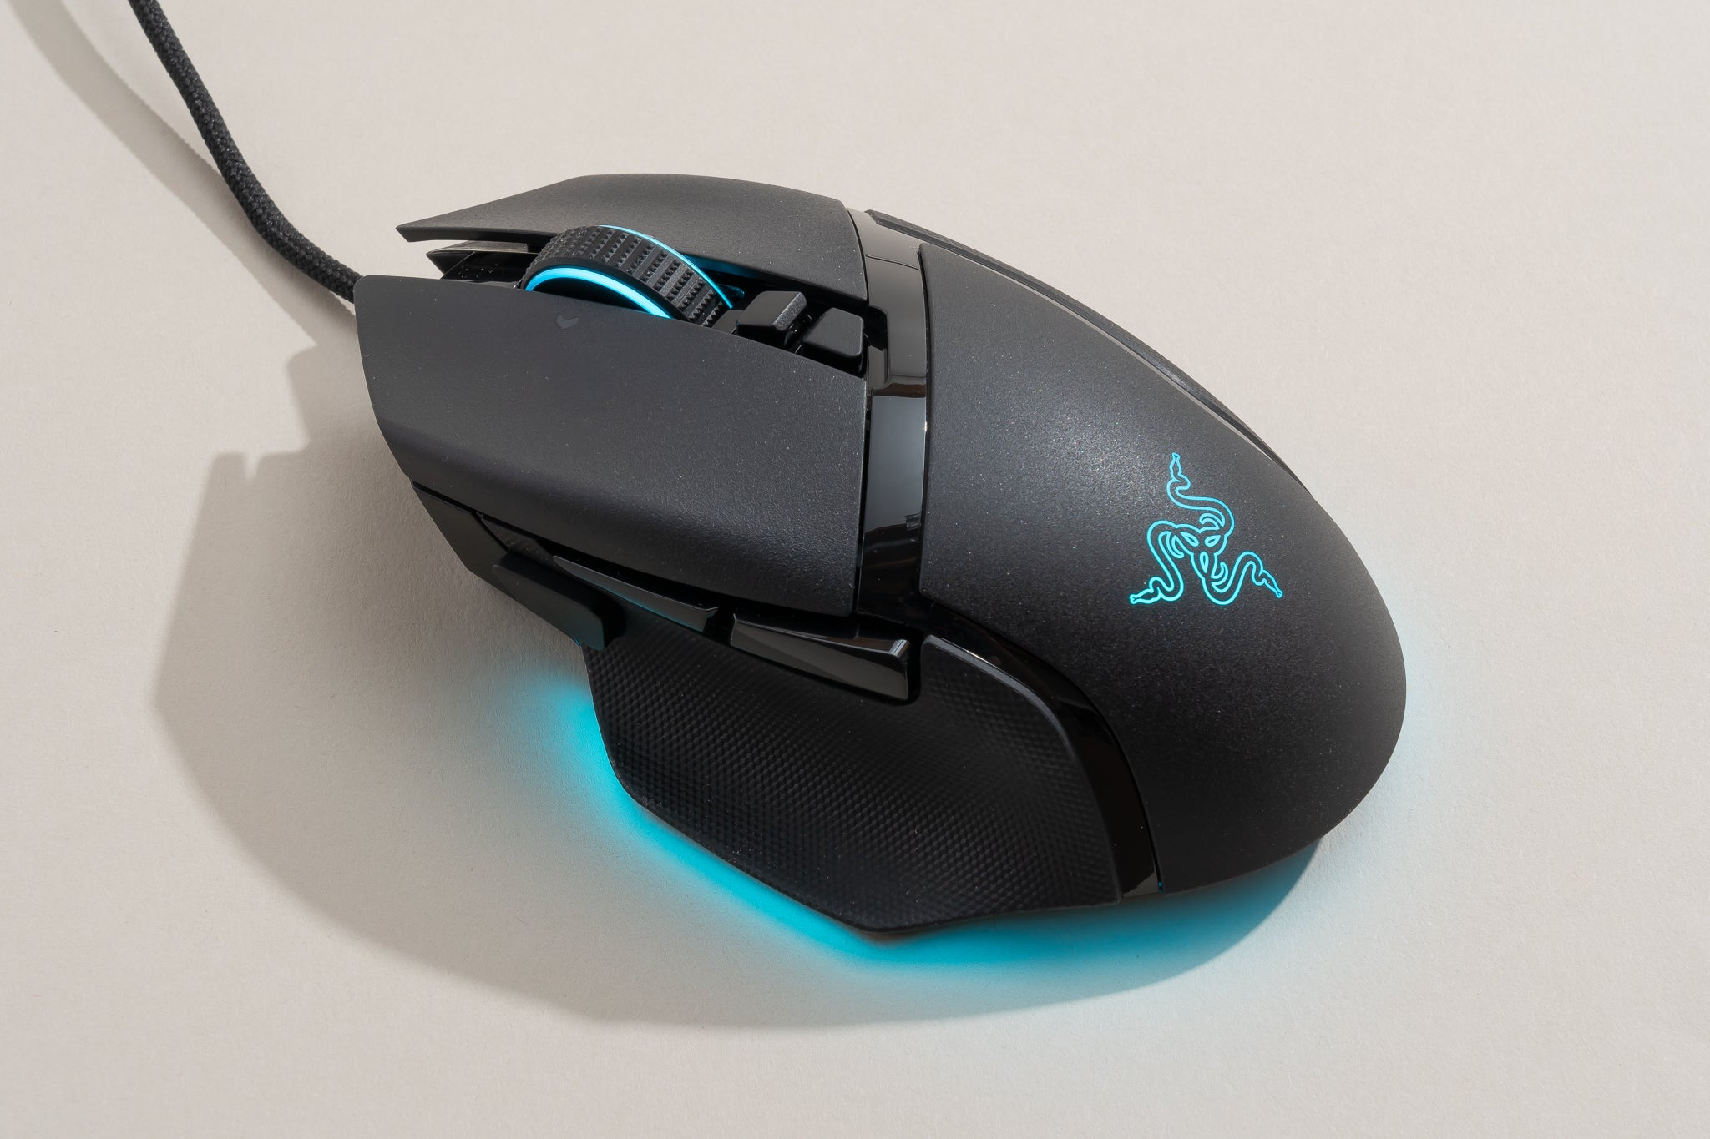
Mouse
In computing ,a mouse is a pointing device that detects two-dimensional motion relative to a surface .
This motion is typically translated into the motion of pointer on a display , which allows for fine control of a graphical user interface.

Slide 9
Keyboard
A keyboard typically has characters engraved or printed on the keys and each press of a key typically corresponds to a single written symbol.
However , to produce some symbols requires pressing and holding several keys simultaneously or in sequence .While most keyboard keys produce letters , numbers or signs (characters), other keys or simultaneous key presses can produce actions or execute computer commands.

Slide 10


